Slide 1
Quantifying Student Success
At Santiago Canyon College
CSUF Statistics and Data Science Cesar Pardede, Ezra Mock, Marc Sanchez, Mike Smith
Santiago Canyon College Mentors Aaron Voelcker, Haydeh Kaveh, Mahbod Parvar
Math 539 Statistical Consulting Dr. Sam Behseta, Dr. Jessica Jaynes

Slide 2
THE PROBLEM
The student population is inherently diverse and there are many socio-economic barriers that may hinder a student‘s educational progress. This project aims to help identify at-risk students for potential intervention to assist in and ultimately increase student success.

Slide 3
CSUF PROJECT TEAM
Mike Smith
Cesar Pardede
Marc Sanchez
Educator, Statistician,
Programmer
Mathematician
Ezra Mock
Math Faculty
Analytic Science

Slide 4
Project Roadmap
Goals and Objectives
Literature Review
Big picture view and scope of the project
Recap of relevant literature and previous research
The Raw Data
Exploratory Data Analysis
Data visualization and pattern recognition through clustering
Structure, composition, wrangling, and transformations
Findings and takeaways
Modeling
Project summary, key finding and potential future work
Variable importance, modeling techniques and model comparisons

Slide 5

"The road to success and the road to failure are almost exactly the same." Colin Davis

Slide 6
Goals and Objectives

Slide 7
Primary Objectives
First Objective
Third Objective
Completion Metric
Second Objective
Top Predictors
Which is a better response variable for determining student success, percentage of completed units or courses?
What are the top predictors for student success and student non-success ?
Income Identifier
Does using a student’s address provide the same predictive value as low-income status?
Notes:
Our projects objectives are based on the research questions of our client. We were given 3 main research questions. (Read objectives).

Slide 8
Secondary Project Goals: Did COVID-19 impact our results?
Measuring Success
Predictor Stability
Income Analysis
Was there a distinguishable difference in the quality of our metrics for success?
Did the variables that we found to be important change with the onset of the pandemic?
Did living in a low income area influence success more heavily during COVID?

Slide 9
Thresholding Student Success
Units Based
Course Based
Unit Based
Course Based
Student completed 100% of attempted units
Student completed 100% of attempted courses
Student completed at least 80% of attempted units
Student completed at least 80% of attempted courses
Notes:
Finally were tasked with finding the better thresholds for defining success and non-success. Again, we’ll be measuring as both percent of units completed or percent of courses completed for a given term. Each of these will be measured either at the 100% level or 80% level and above.

Slide 10
Thresholding Student Non-Success
Units Based
Course Based
Unit Based
Course Based
Student did not complete 100% attempted units
Student did not complete 100% attempted courses
Student completed less than 80% of attempted units
Student completed less than 80% of attempted courses
Notes:
Student non-success is measured with the same variables

Slide 11
Literature Review
Notes:
We conducted a review of published literature dedicated to studies in this space. We’d like to quickly summarizes some interesting and noteworthy items we came across.

Slide 12
Main Takeaways from Literature Review
Online Course taking and Student Outcomes in CA Community Colleges
Supporting Latino Community College Students
Early Outcomes for CUNY ASAP
Enrollment has increased over the last 10 years, but degree completion for Latino students has not grown as quickly (Santiago 2013)
Program to increase student success led to 55% graduation rate vs. the 23% control group, when providing additional incentives (Linderman 2013).
In general, students are more likely to succeed in face-to-face courses vs online-courses (Hart 2018).
Notes:
CUNY (City University New York) ASAP (Accelerated Study in Associate Programs) tuition waivers for financial aid-eligible students, monthly Metrocards, small class size, career development and textbooks

Slide 13
The Raw Data

Slide 14
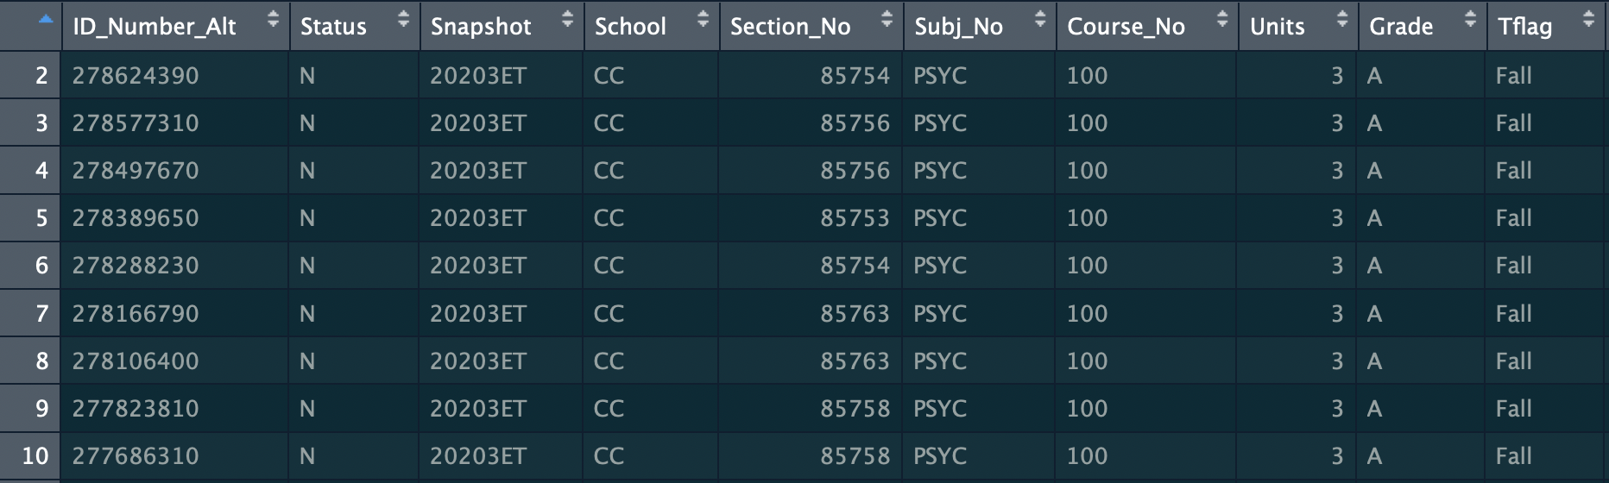
Data Structure
The data file consisted of 340,151 rows and 55 columns
Each row uniquely identifies a single course taken by a SCC student spanning from Summer 2015 through Fall 2020
The covariates represented in the columns describes some attribute of that course, semester, student, student history, or course outcome.
Some were reported by the student, some were reported by college, some were derived by the SCC team, and some were ultimately derived by us.

Slide 15
Data Composition
Academic Based
Demographic Data
There are basically two categories of data within the columns
Term
Grade
Units Per Course
Total Units Attempted
etc
Age
Gender
Income Status
Address
etc

Slide 16
Variable Types
Quantitative
Qualitative
Semester Attempted Units
Semester GPA
Cumulative Units Passed
Cumulative GPA
Age
Median Income (more on this later)
Subject (Math, English, History etc.)
Grade (A, B, C, Pass, Withdrawal etc.)
Academic Standing (Good, Honors, NA etc)

Slide 17
Flavors of Quantitative Variables
Continuous
Binary
Discrete
The original data had just a handful of true continuous variables relating to locations or GPA
Some of our discrete variables had been transformed from categorical by SCC
Good examples of our binary variables are the “First Generation” flag and “Athlete Ever”
Notes:
Semester and cumulative GPA are continuous. Recall we have multiple response variables. % courses taken/dropped/passed/successful is derived and continuous (more on this later). Discrete variables like Age, Year etc. Some of our binary variable (i.e. SG_First_Generation) we’re translated to numeric flags by the SCC team and then distilled down to binary outcomes. Students reported how much, if any, college was taken by parents (no college, some college, lots of college, excessive amounts of college etc)

Slide 18
Qualitative Variables
Grade: though grades given are categorically, we have this info in a binary flag. (A, B, C, P) = 1
Gender: This variable is less straightforward than you may think.
Ethnicity: This is potentially a hot-button variable. Need to careful with how it’s used
Term: This will ultimately be dropped from any modeling efforts, but it’s used initially to derive other attributes
Notes:
Much of the this rich dataset is categorical in nature. Take grades for example. If we’re looking to predict student outcomes then the grade given is obviously a critical field. Passing grades include A,B,C or P. We have a variable called “passed” which is a flag which supersedes the “Grade” variables. The $100 question is do we trust the passed flag? Can we validate it?

Slide 19



Referring back to the stated goals of this project, Can these questions be answered
with the data as it was provided?

Slide 20
Turns out the answer is NO
...but in the next few slides we will talk through what we’ve done to remedy that

Slide 21
Data Wrangling
Data Transformations
Total # of Classes by Term
Total # of Classes Dropped
Day Classes Only
Classes Passed
Athlete ever
Proportion of Successful Units by Term
Data Cleaning
Removed extreme outliers
Remove uninformative covariates
Remove Missing Data (less than 5% of data. )
Math and English within 1st year
Gap Year
Persistent Fall and Spring
Proportion of Successful Units and Courses, where > 0.8 is Success.
Low income variable by zip code (median income)

Slide 22
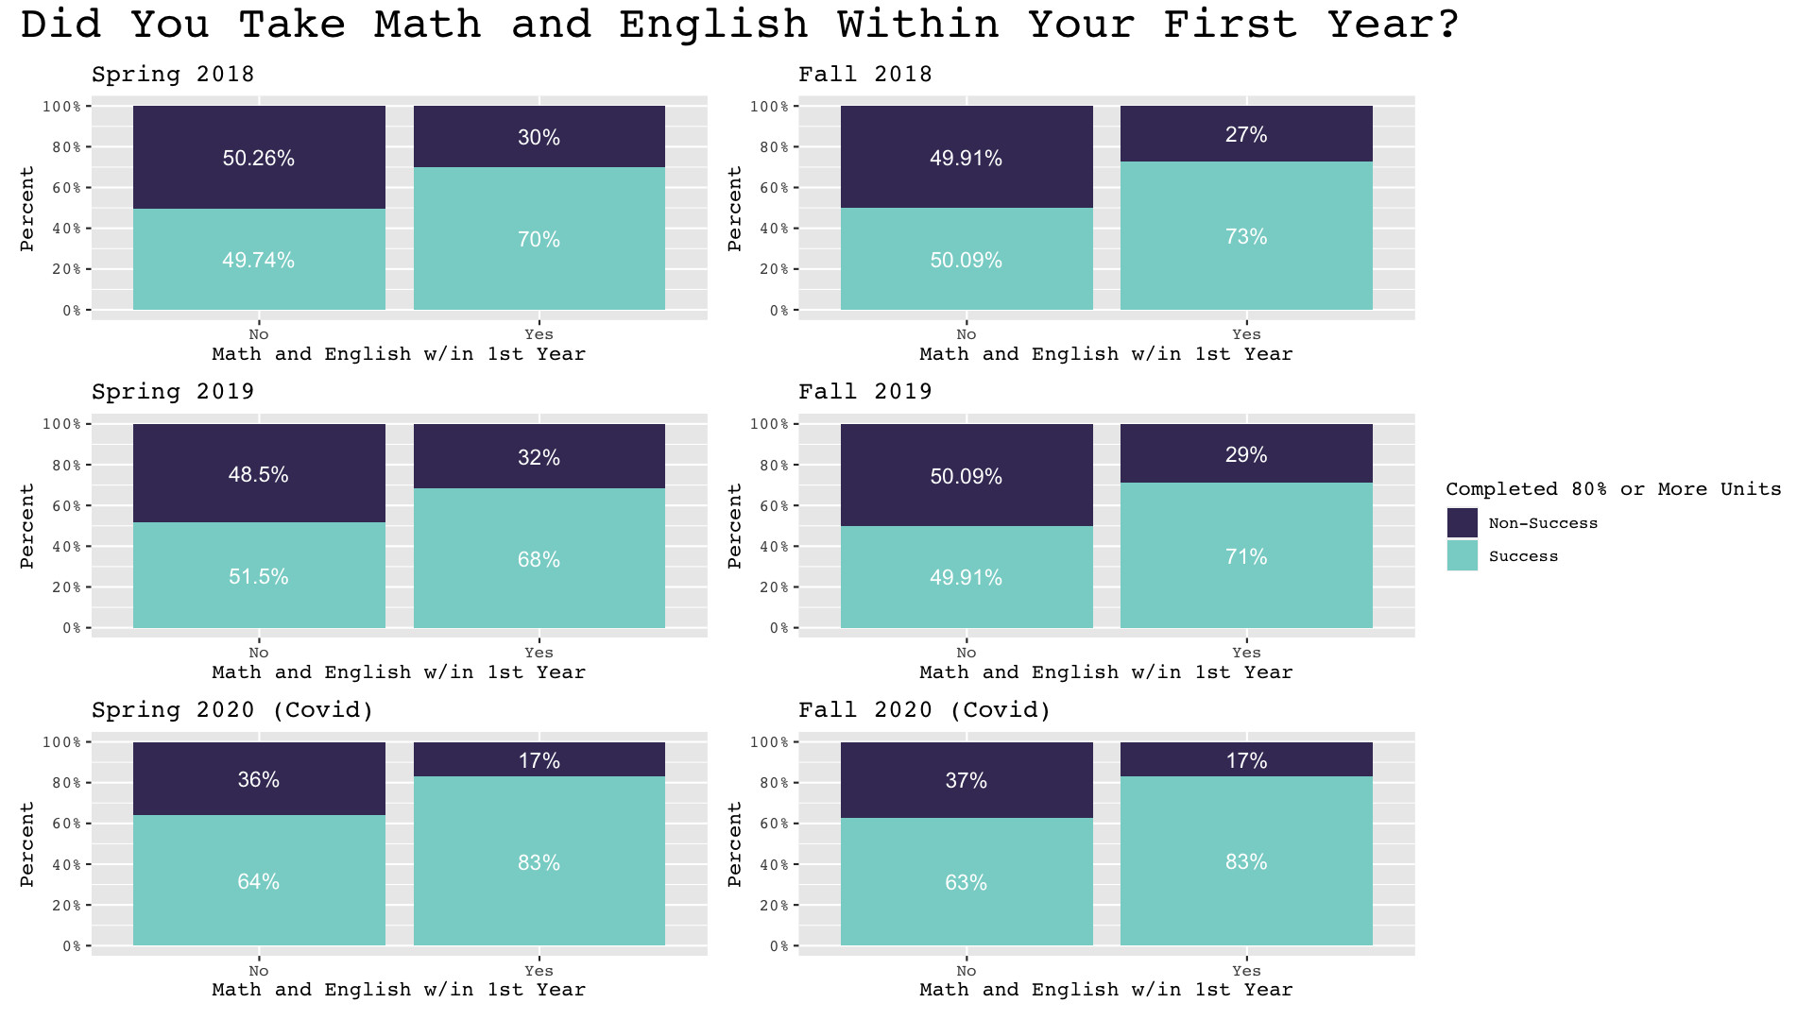
Data Transformations
This plot shows more students obtain the 80% threshold when they take Math and English within their first year.

Slide 23
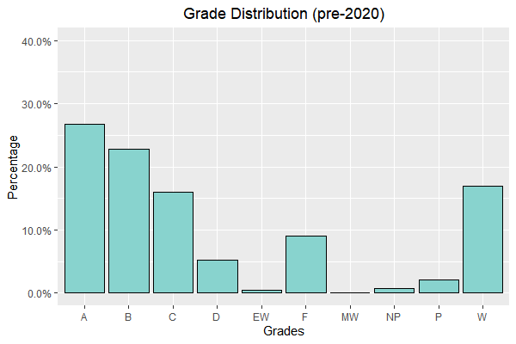
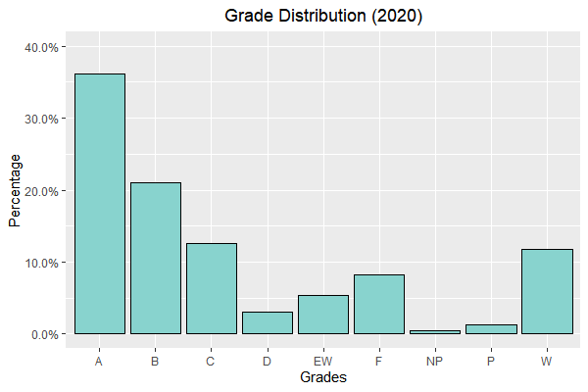
Evaluating Students in a Pandemic
Grade distributions (before and during COVID-19)
Increased A’s and EW’s, decreased B’s, C’s, D’s, F’s, and W’s.
Notes:
EW is a Covid Withdrawl, NP is not pass, P is pass, W is withdrawl

Slide 24
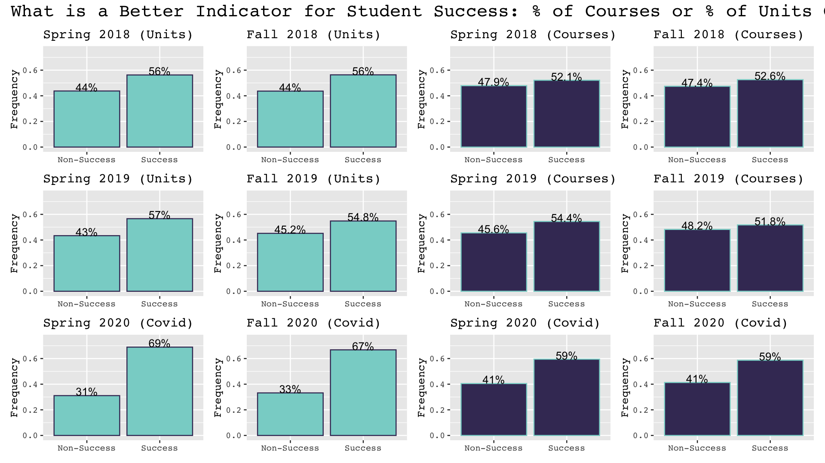
Which is a Better Metric of Student Success: Units or Courses?
Was there a Change in Success during Covid Terms vs. Non-Covid Terms?
Each Row is a Year
Teal: Units Threshold
Purple: Course Threshold

Slide 25

Which is a Better Metric of Student Success:
Units or Courses?
Logistic Regression for Units vs. Courses
Test Statistic = 20.81
When going from courses to the units threshold, your odds for success are 22% higher for succeeding.
The remainder of the presentation will only focus on units metric for success.

Slide 26

Was there a Change in Success during Covid vs. Non-Covid Terms?
Logistic Regression for
Covid vs. Non-Covid Terms
Test Statistic = 26.87
When going from Non-Covid terms to Covid terms, your odds for success are 68% higher for succeeding.

Slide 27


Revisiting the Objectives
Relating back to the goals of this project, how can we determine if low income status provides similar predictive value as living in a low income area...

Slide 28
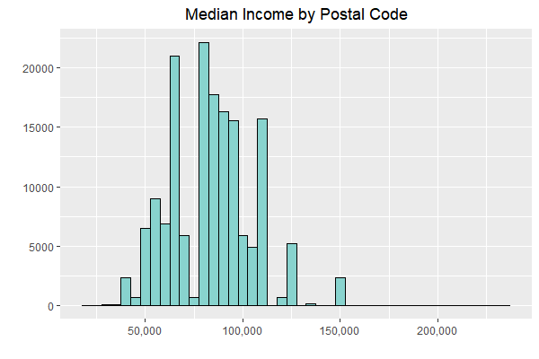
Median Incomes of Students’ Zip Codes
We obtained an income dataset based on the 2010-2014 American Community Survey (ACS).
This dataset relates zip code to median and mean incomes.
We used the HUD definition of low-income (not more than 80% of the State median).
Using this threshold we determined which zip codes were likely to be low-income.
Then we appended a new binary flag to each student indicating the income category (low/other) for the zip where each student resides
Notes:
Housing Urban development
~60k is our threshold

Slide 29
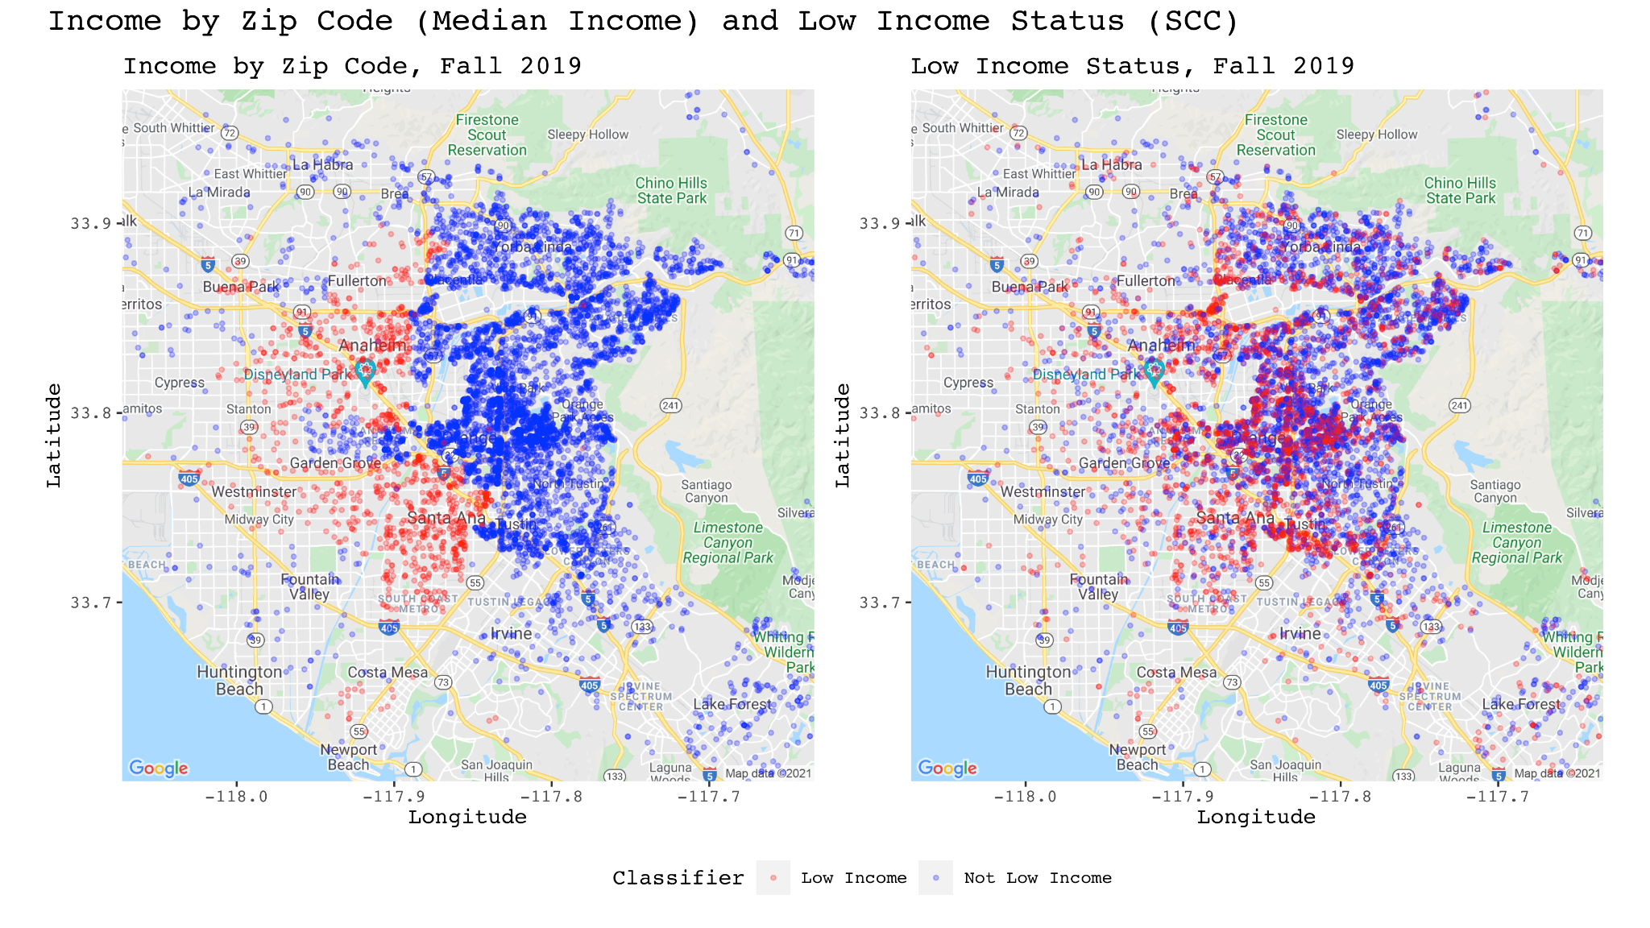

Slide 30
Accessing Predictive value
By building a simple logistic regression model with a single predictor, we can do a direct, head-to-head comparison of the the income variables in question.
The Low Income variable (based on Zip Code) has better predictability.
Looking at 2020 only (the COVID Terms),the provided low income status variable gave better results.
Low Income Location
Low Income Status
Non-Covid Terms
Test Statistics =-9.30
Non-Covid Terms
Test Statistics = -4.17
Covid Terms
Test Statistics =-1.9
Covid Terms
Test Statistics =-5.12

Slide 31
Exploratory Data Analysis

Slide 32



K -Prototype Clustering
Huang (1998) extensions of the well-known K-Means algorithm that is suitable for mixed data
This clustering algorithm uncovers associations between individuals
K-Prototypes works by minimizing the within sum of squared error (WSSE)
2.0 <GPA <3.0
Drop Courses =1,2,3
Female = 20%
GPA < 2.0
GPA > 3.0
Drop Courses > 3
Drop Courses = 0
Female = 10%
Female = 70%

Slide 33
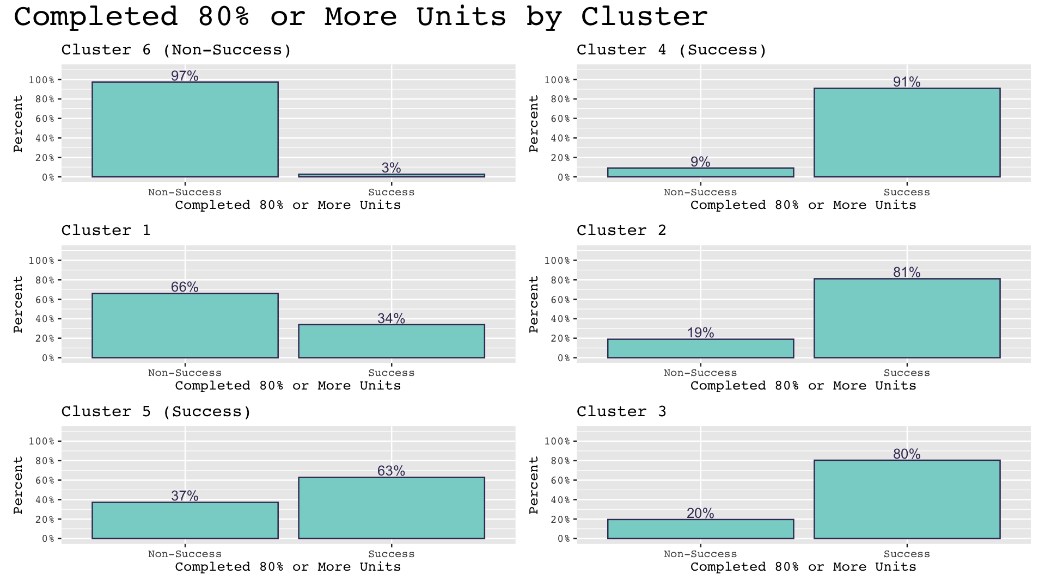
Clustering Outputs
Clusters 6,1,5 : have higher % of Non-Success
Clusters 4,2,3: have higher % of Success

Slide 34
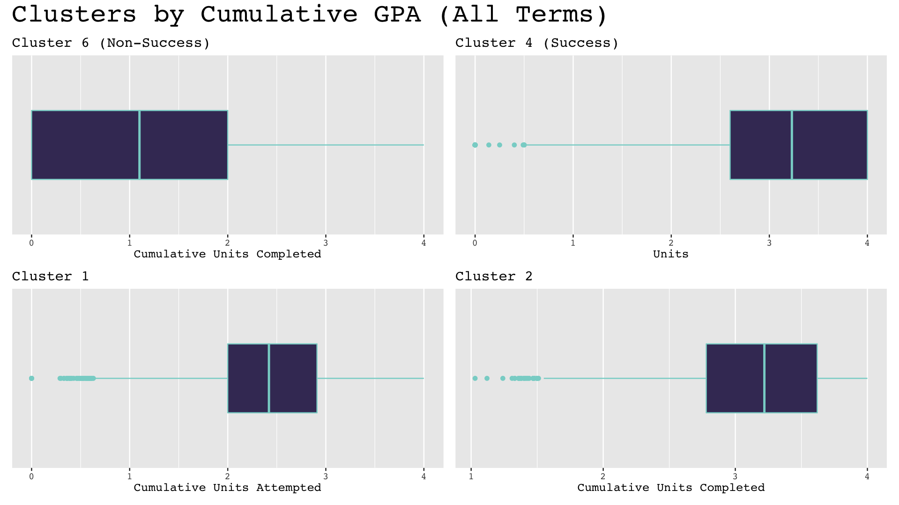
Clustering Outputs
Clusters 6, 1: lower GPA, on avg.
Clusters 4, 2: higher GPA, on avg.

Slide 35
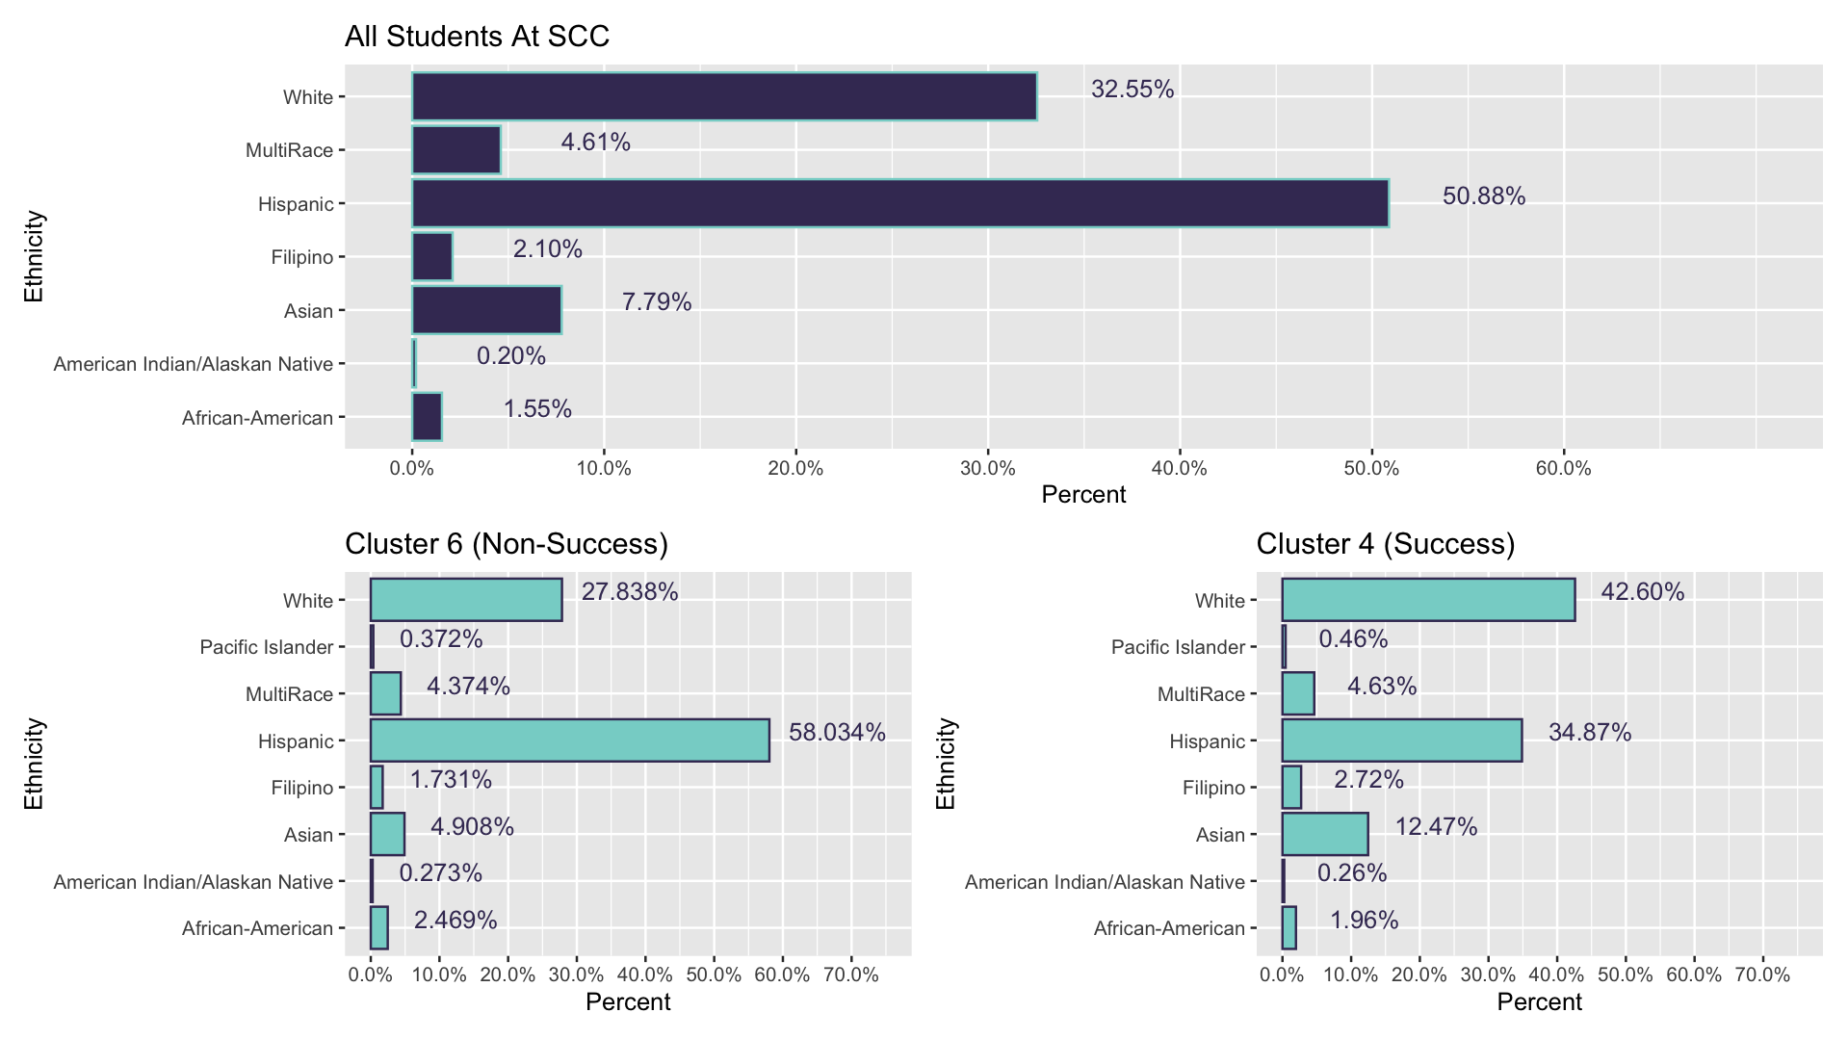
Ethnicity and Student Success
Cluster 6 has a higher percent of Hispanic students (58.034%) than population percentage (50.88%)
Cluster 4 has a lower percent of Hispanic students (42.60%%) than population percentage (50.88%)

Slide 36
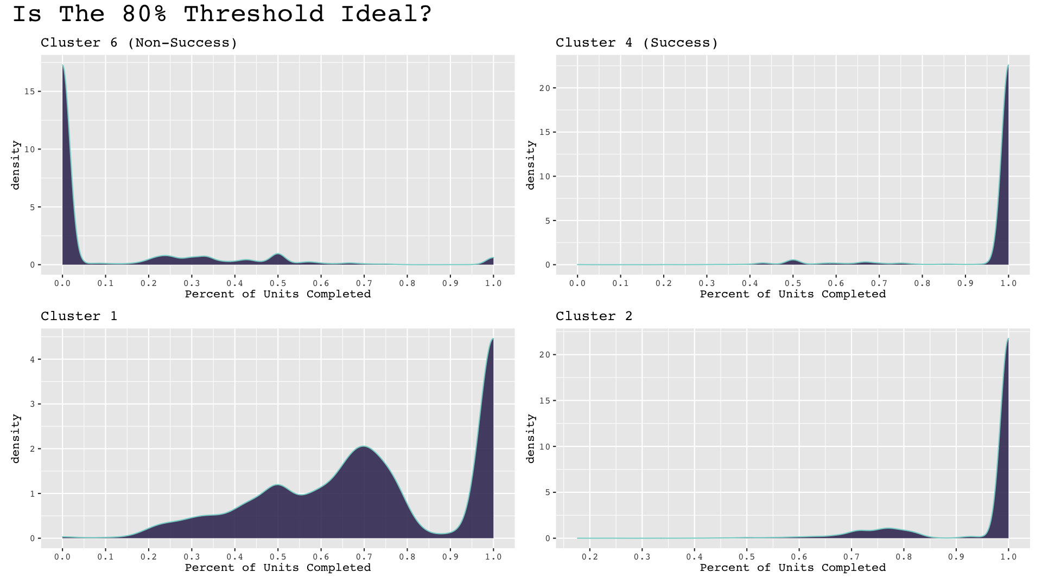
Should we use the 80% Threshold or 100% Threshold?
Takeaways
Clusters 4 and 2 (higher success clusters) have
highest density nearby 100% units completed
Clusters 6 (lowest success clusters)
save density near zero and Cluster 1 is a mix
The 100% threshold is too stringent allowing no room for error

Slide 37
Advantages of Clustering
P
R
O
S
Handles correlated covariates
Uncovers hidden patterns
No parametric assumptions needed
Can handle missing or sparse data

Slide 38
Variable Importance
We used regularization methods and random forests with various importance metrics to find which variables have the greatest impact on success and non-success.
Notes:
After our exploratory findings, we used regularization methods and random forests with various importance metrics to find which variables have the greatest impact on success and non-success. I’ll go over each of the regularization methods, random forests, and importance metrics in the coming slides.

Slide 39
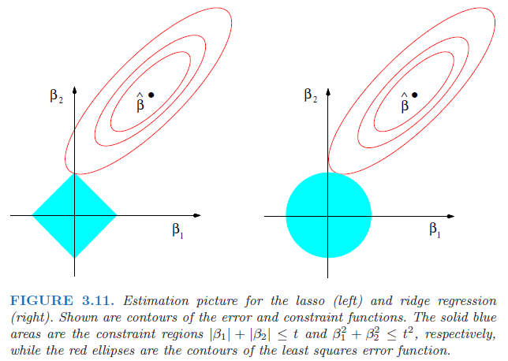
Regularization Example
Notes:
Just a quick overview of regularization methods. Regularization is the method of fitting a linear regression model with a penalty term to avoid overfitting and allow a more flexible model.
Here is a simple two-dimensional example where the beta 1 and beta 2 axes represent coefficients for two variables. The point, beta hat, is the optimal solution to an ordinary least squares regression model. Each red ellipse represents an error bound around the ordinary least squares solution to allow a more flexible model and the blue regions are potential solutions for regularization.
Essentially, where the red ellipses contact the blue regions are the coefficients for regularization.
On the left is LASSO, it has the potential to contact the blue region on a corner, and in doing so can eliminate variables from the model. In this case, the coefficient for beta1 would be set to zero.This would be useful if we have a large number of predictor variables, and some of them were not correlated to the response variable, we could remove them from consideration.
On the right is RIDGE, which has a circle shaped solution region. With RIDGE, we can shrink variable coefficients close to zero, but we cannot bring them all the way to zero (like in LASSO), so we’ll always have coefficients for every variable in consideration, even if they are not related to the response.
A third type of regularization not shown here is called ELASTIC NET. It is a hybrid of LASSO and RIDGE, and you can imagine its solution region to look like a spiky ball with spikes at the axes.

Slide 40
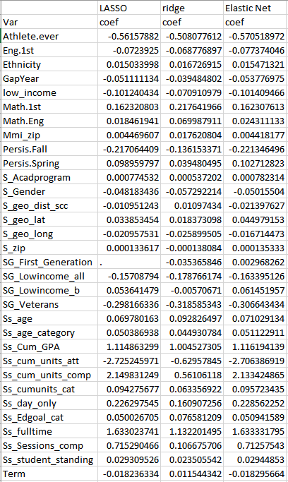
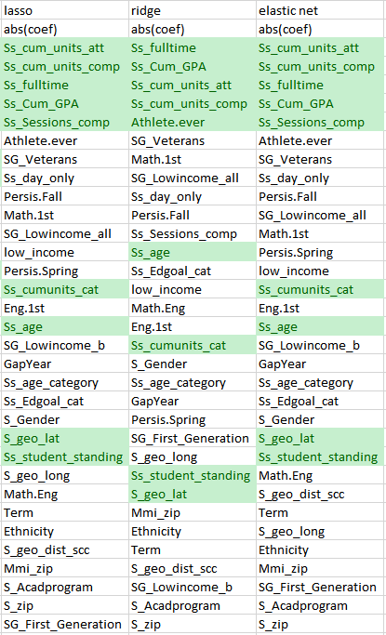
Regularization for Variable Importance
Variable coefficients
Variable rank
Lasso
Ridge
Elastic Net
“Importance” is measured by the magnitude of the model coefficients for variables.
Bigger means more important.
Notes:
It’s difficult to visualize it higher dimensions, but we used these three regularization methods to get coefficients for each of the predictor variables. (We removed semester units and course variables because those variables were used in calculating the response variables). In regularization, we measured the importance of a variable by the absolute value of the coefficient for that variable. A larger absolute value coefficient means that variable has a greater impact on the response and is a more important variable for prediction.
Then we ranked each of the variables by importance in the table on the right. The top five variables for each method are highlighted in green. The highlighted variables below the top five are important variables from random forests that I’ll talk about in a moment.

Slide 41
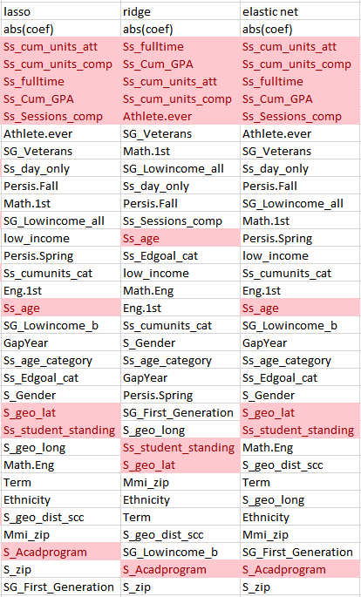
Regularization for Variable Importance
Top Variables for Success
Top Variables for Non-success
Notes:
We repeated this process to find the most important variables for non-success as well. You’ll notice these lists look very similar.

Slide 42
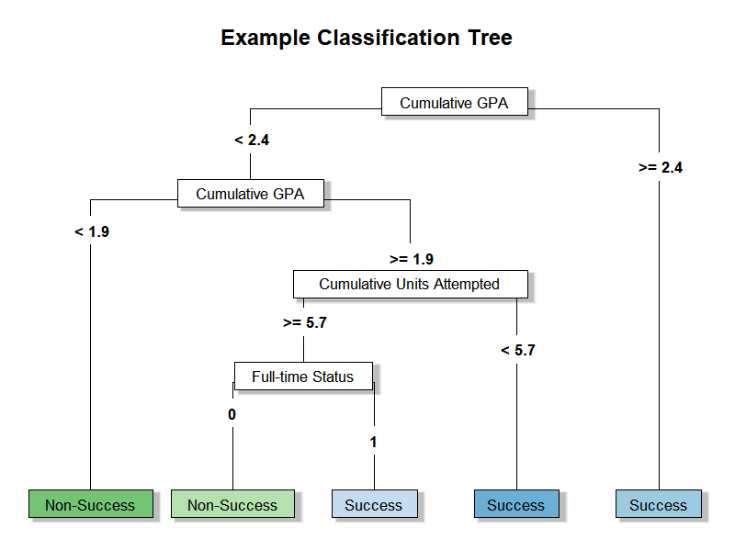
Random Forests Example
Notes:
As I mentioned earlier, we also used random forests to rank variables by importance. Random forests are collections of classification trees, we have an example of a classification tree on the screen right now. As you go down the classification tree, it splits the data based on some condition related to the variables. In this example, if a student had a cumulative GPA greater than or equal to 2.4 in a term, the classification tree classifies them as a success. If they had a cumulative GPA less 2.4, but greater than or equal to 1.9, the classification tree checks if the student attempted more or less than 5.7 units in a term, then whether they were in a full-time status or not.
Random forests create many of these classification trees by splitting at random variables. Then, random forests use the majority vote of all the trees in a forest to classify a student in a term as a success or non-success. Although a classification tree by itself may be a weak predictor (not accurate by itself), together in a random forest they make a strong predictor.

Slide 43
Random Forests for Variable Importance
Classic RF
Ranger
RANdom forest GEneratoR
Fast implementation of random forests good for high-dimensionality data
Regularized RF
Discourages splitting on a new feature unless there is substantial information gain
“Importance” is measured two ways:
Impurity
Gini or adjusted Gini
Mean decrease in impurity for all tree splits
Bigger means more important
Permutation
Decrease in accuracy if the values of the variable were shuffled
Bigger means more important
Notes:
We used three different kinds of random forests.
Classic RF is the version I just explained.
Ranger: RANdom forest GEneratoR
Fast implementation of random forests good for high-dimensionality data
RRF: Regularized Random Forest
Penalizes splitting on a new feature unless there is substantial information gained from the split
Then we used two different measures of importance to find the important variables in each type of forest.
Impurity measurements measure how “cleanly” a variable can split up the success and non-successes. If a split does a good job of putting all the successes on one side, and all the non-successes on the other side then we’d say that variable is important. The mean decrease in Gini measures the impact on classification of removing a variable split from all trees. A larger mean decrease in Gini or adjusted Gini means a variable is more important.
Permutation accuracy measures the impact on correct classification if the values of a variable were shuffled. If shuffling the values of a variable make it harder to classify, then that variable would have a larger permutation accuracy measurement. A larger permutation accuracy means a variable is more important.

Slide 44
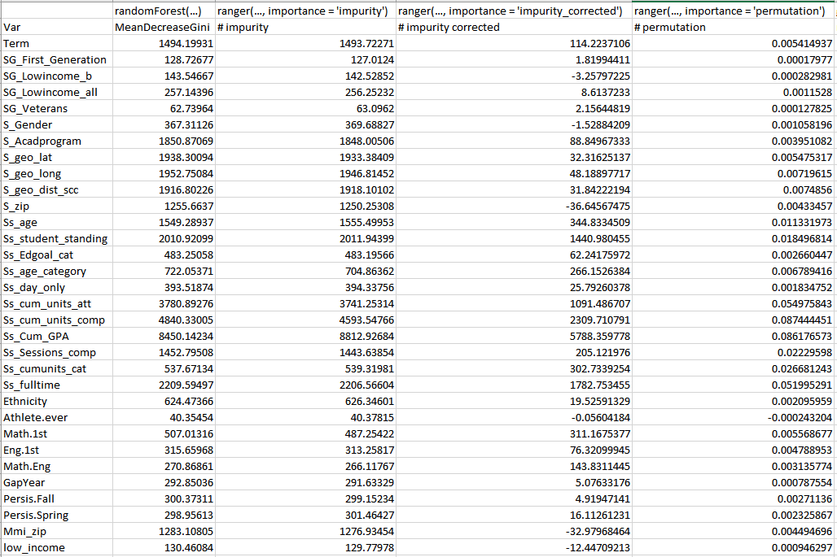
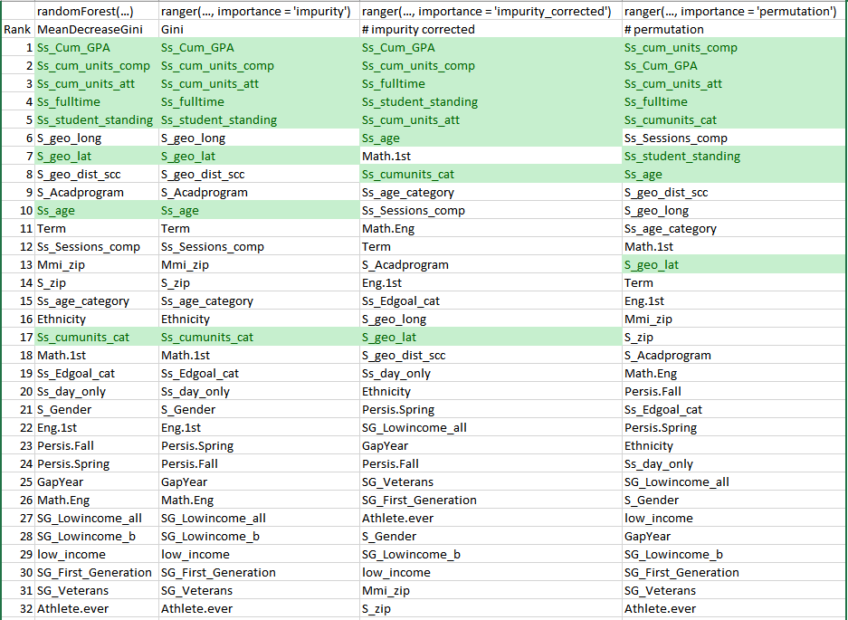
Some important variables for success (>80% units passed)
Notes:
We do the same thing as we did before for the regularization methods. We find the measure of importance of each variables in each random forest method for each importance measurement available to each method. Then we rank them.
Here, the top five variables for each method are highlighted in green with the highlighted variables below them being additional variables that showed up in the top five from regularization or other random forest implementations not shown in this table.

Slide 45
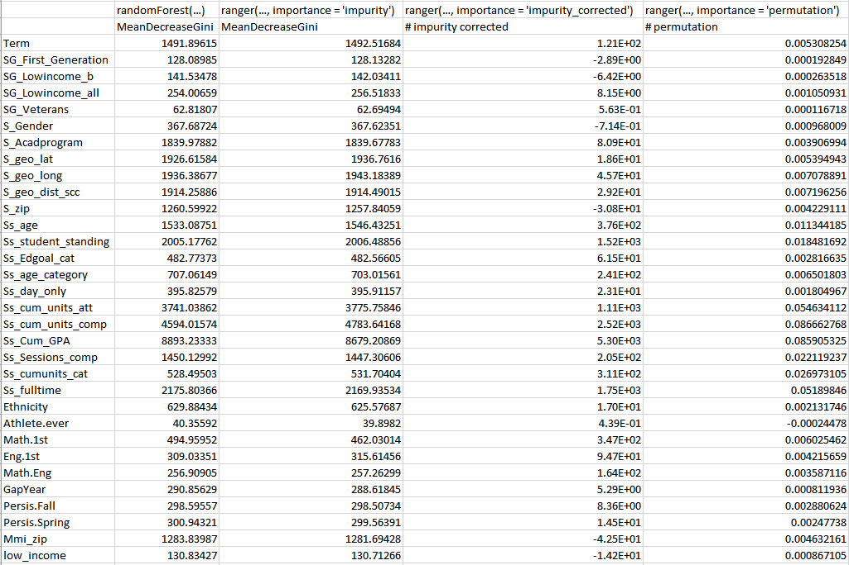
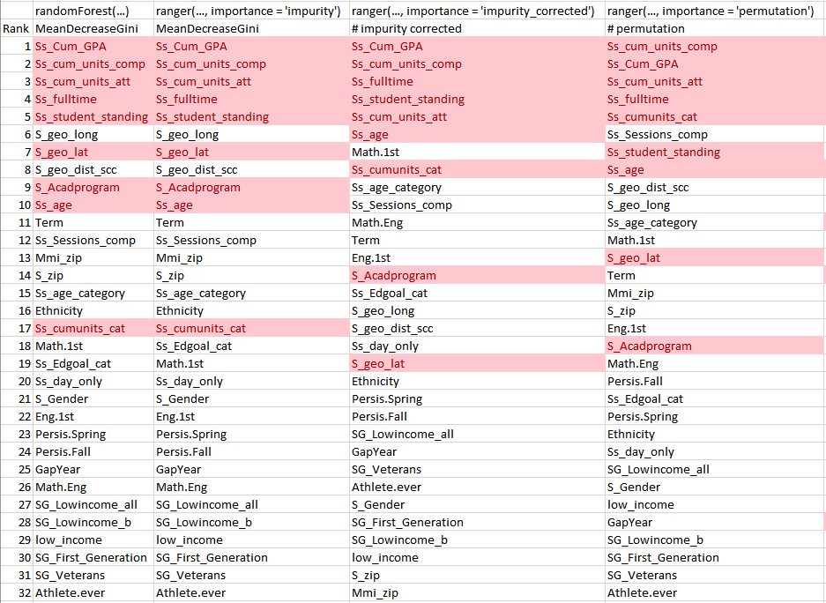
Repeat for non-success...
Notes:
We repeat the process for non-success, and notice the top ranked variables are very similar to the top-ranked variables for success.

Slide 46
Common Variables
Among all methods of variable selection and measures of importance, nine variables frequently appeared among the most important.
Cum. GPA
Cum. Units Comp.
Cum. Units Att.
Full-time Status
Age
Cumulative GPA
Units completed
Units attempted
Full-time or part-time
Student’s age
Student Standing
Sessions Comp.
Geo. Latitude
Geo. Longitude
Academic Standing
Number of terms completed
Latitude of student’s address
Latitude of student’s address
Looking at 2020 only (COVID Terms), these same variables ranked among the most important, though their order may be shuffled.
Notes:
We repeated random forests on the other response variable (courses completed) and 2020 terms only, and these are the top nine variables that frequently ranked among the most important to student success and non-success: (read slide variables).
When we looked at 2020 terms only, the same variables still ranked among the most important, but the order might have been switched around in some instances.

Slide 47
Model Techniques
Now that we have rigorously confirmed which covariates would contribute in a meaningful way to the prediction of student success, we wanted try our hand at making those predictions
Notes:
(Read slide). We have a list of the most important predictors, now we need to see well those predictors actually predict success and non-success.

Slide 48

Things to Consider When Choosing a Model
What type of data do we have? Mixed data
What form do our response variables take? Binary
How large is the dataset? 86,000 x 55
Are there computational constraints? Always
Is interpretability important? Yes
Does our model need to be reusable? Yes
Notes:
When choosing a model, there are a number of things we have to consider such as the: type of data we have, what form do our response variables take, and how large is the dataset?
As always, we have to keep computational constraints in mind; there’s no point choosing a sophisticated model we don’t have the time or resources to do. Our model also needs to be interpretable; we want to be able to know what a model is doing, and be able to explain it. Finally, our model needs to be reusable; that means whatever model we choose needs to be flexible enough that it can be used in the future with new data.

Slide 49
Answering the above we decided on the following
LASSO Regression
Logistic Regression
Random Forest
A reliable technique where variables can be inherently correlated
Due to binary response variable, the logistic regression was deemed appropriate
We want to explore a non-parametric technique that could handle both categorical and numeric
Notes:
With all those considerations in mind, we decided on the following three models.
LASSO regression and random forests we’ve already talked about in the variable importance section, we want to use them again for modeling.
Due to the binary response variable, we also decided to use logistic regression.

Slide 50
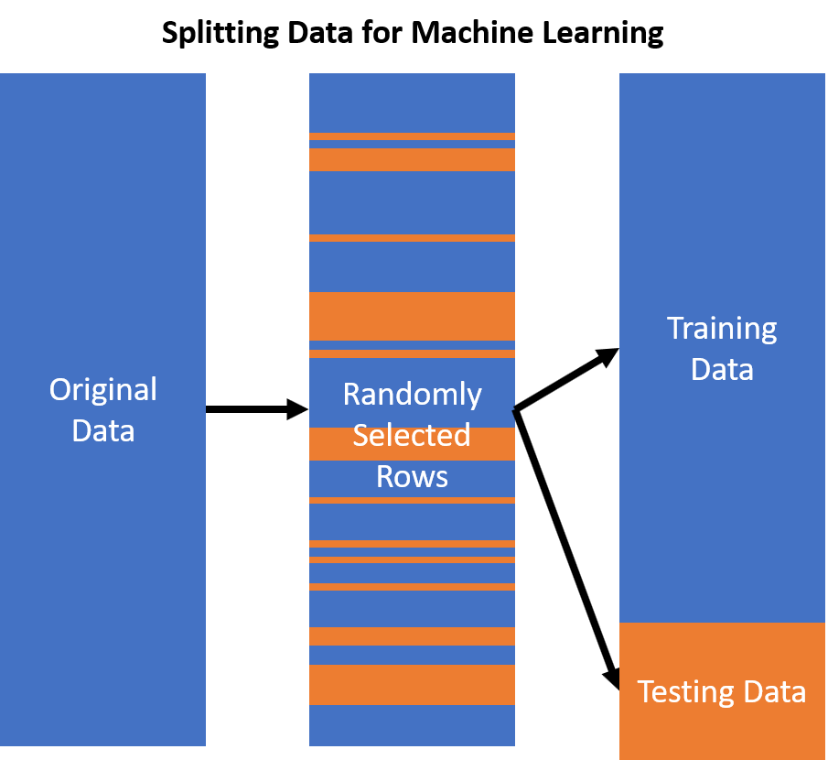
Data Partitioning for Modeling
Separating data into training and test datasets is an important step in evaluating statistical models.
Data was randomly split, 80% training set and 20% test set
Response was 80% success by units
Allows us to quantify the accuracy of our models in a deterministic way
Notes:
To build and test our models, we randomly split our data into training and testing sets, with 80% of the data going to training the models, and 20% used to test the models. We trained our models on the training data, made predictions on the testing data, then recorded the accuracy of our prediction against the testing data.

Slide 51
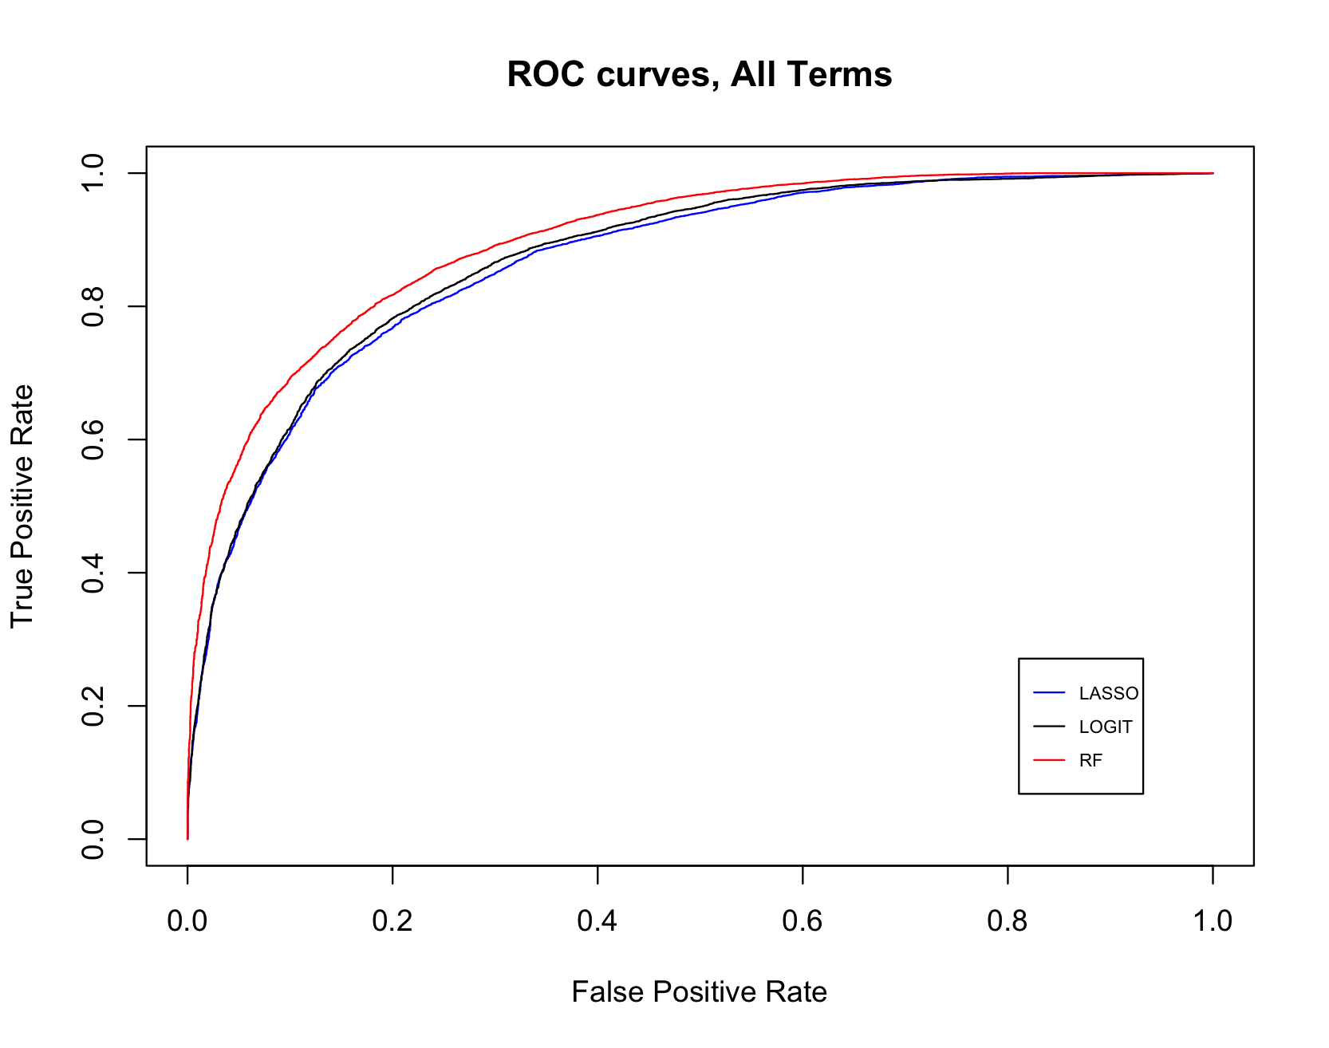
Model Evaluation
After our in-depth exploratory analysis, and the reduction of dimensionality resulting from the variable importance ranking, we built the aforementioned LASSO, Logistic, and Random Forest predictive models. The ROC curves on the left give us a visual way of comparing the performance of these models.
Notes:
(read slide) Classifiers with ROC curves closer to the upper left corner indicate better performance. As a baseline the line y = x signifies no predictive value. Notice how the LASSO and LOGIT plots are close to each other showing that the models are giving a similar performance, with the Random forests doing slightly better.

Slide 52
Accuracy and Area Under the Curve
Model | Accuracy | AUC
LASSO | 0.787 | 0.867
Logistic | 0.796 | 0.873
Random Forests | 0.814 | 0.898
Notes:
Here we have a numerical summary and comparison of each model’s performance. The accuracy and area under curve give us numerical summaries of how the models performed on data that was not used for training. The closer these numbers are to one the better the performance is. Notice that this table is repeating what was seen in the ROC curves; LASSO and Logistic regression perform similarly to one another and Random Forests perform slightly better than both.

Slide 53
Key Findings and Takeaways

Slide 54
Primary Findings
Completion Metric
We established that the 80% threshold for Unit Completed was the best response variable for all terms (including COVID terms).
Income Identifier
We determined that living in a low income area provided more predictive value than the reported low income status and that the opposite was true during the pandemic.
Top Predictors
We discovered that the same nine variables were frequently found to be important predictors for success and non-success (even during COVID).

Slide 55
Future Considerations
Eliminate Current Term Data
Success Thresholding
Additional Modeling Methods
For a predictive engine like those discussed here to truly perform as an early warning system it would need to be executed early/mid semester. This would require the elimination of current semester data like final grades, G.P.A.s, etc
We determined the 100% threshold was too restrictive. Perhaps 80% is not ideal either. It’s likely the best response variable would be derived from a threshold somewhere between 80% and 100%.
Given additional bandwidth we would have liked to investigate how other statistical and machine learning models performed when applied to this problem. For example, neural networks could be an interesting and effective choice.

Slide 56
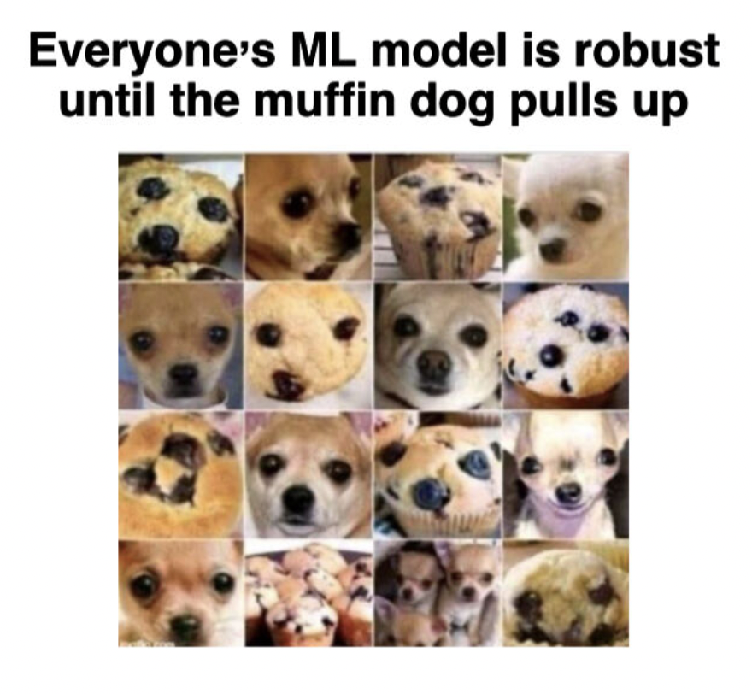
Other Considerations
There’s a lesson to be learned from this image and the following questions should asked:
Would our models perform well on future data?
Could the importance of certain variables wane over time?
Will the Post-Covid era resemble the Pre-Covid era in meaningful ways?
...time will tell
Notes:
The muffin dog strikes fear into the hearts of all data scientists. This boils down to “How long till model degradation sets in and when a models like these need a retrain?

Slide 57
THANKS
SCC Project Team :
Mike Smith Cesar Pardede
Marc Sanchez
Ezra Mock

